Slide 1


Motion Detection Game

Slide 2


Content
Objective
Equipments
Source Code and libraries for ESP32 CAM
Python Libraries for Motion Detection
Motion Detection Algorithm and Testing
Results

Slide 3
Objective
We will develop a Motion Detection project based on Squid Game using ESP32 CAM and OpenCV.
With the help of Python Program and EZSP32 CAM we will develop a Red Light –Greeen Light Game. Here, we will capture the frames of the person moving using ESP32 CAM.
If there is any motion detected in the live video stream when the red light is turned on then the person is dead orgame over else green light is shown in which the person needs to move.

Slide 4
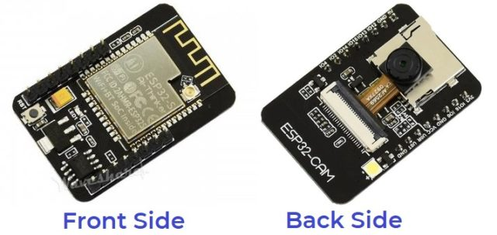
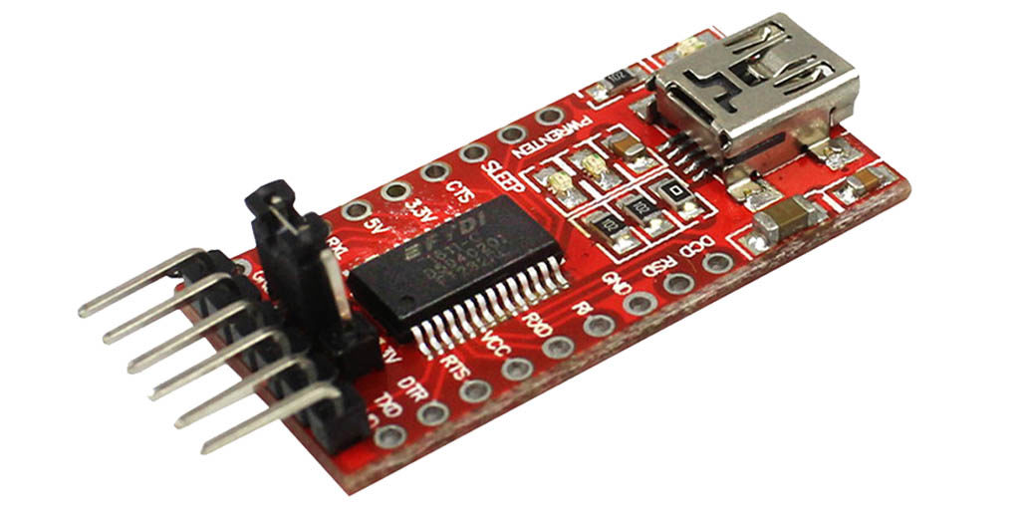
Equipments
ESP32 CAM FTDI

Slide 5
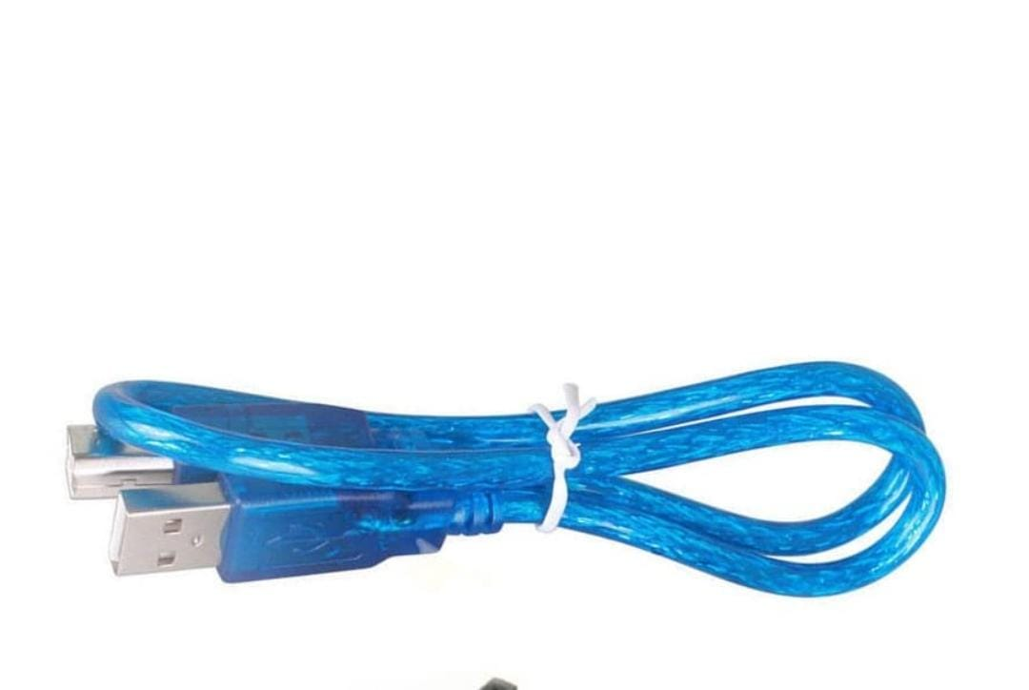
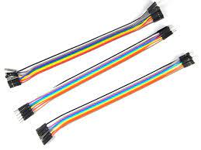
Jumper Wire Cable

Slide 6
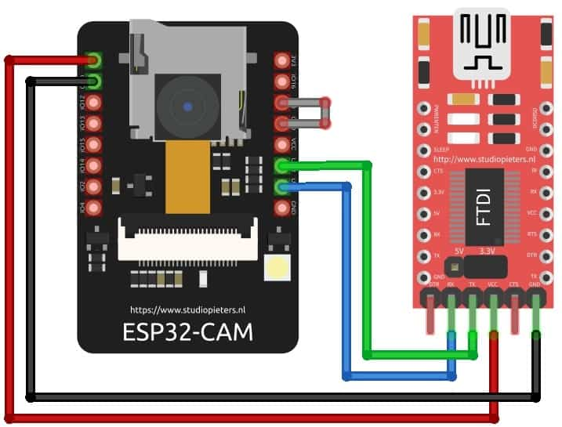
Connection of ESP32 to FTDI
.
ESP32-CAM | FTDI Programmer
GND | GND
5V | VCC
U0R | TX
U0T | RX
GPIO0 | GND

Slide 7
Source code For ESP32
The source code/program ESP32 CAM Motion Detection can be found in Library Example. So go to Files -> Examples -> esp32cam -> WifiCam.
Before Uploading the code you have to make a small change to the code. Change the SSID and password variable and in accordance with the WiFi network.
Now compile and upload it to the ESP32 CAM Board.

Slide 8
Python Libraries For Motion Detection
Required Libraries are
pip install numpy
pip install opencv-python
pip install mediapipe
pip install playsound==1.2.2

Slide 9
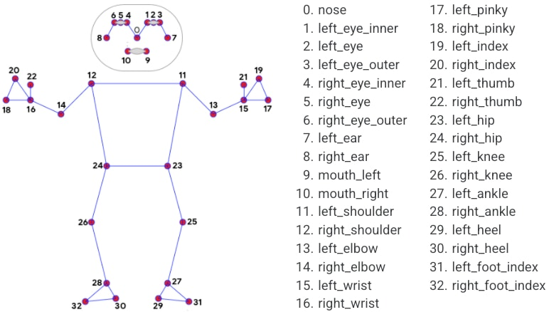
Motion Detection Algorithm
Now to detect motion we are going to use mediapipe library using this we are able to find landmarks of a person standing in front of the camera as in the image below.
Here to detect motion we are going to use landmark no’s 24,23,28, and 27. Because if the person moves then the distance between his hip and alternate foot increases or decreases. For example, if the person moves then the distance between 23 and 28 or 24 and 27 surely changes. Thus, the motion is detected.

Slide 10
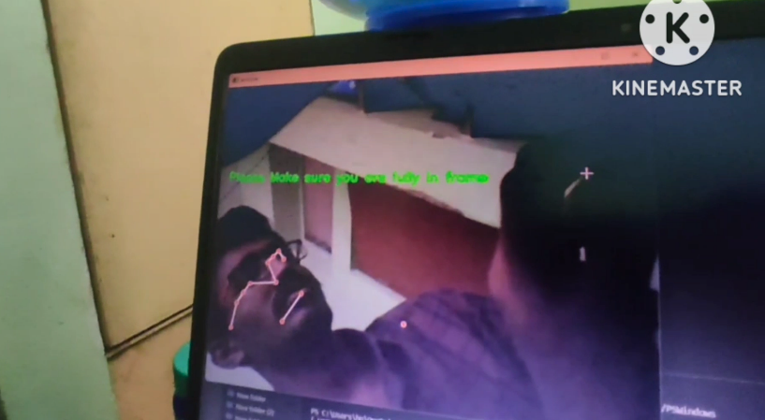
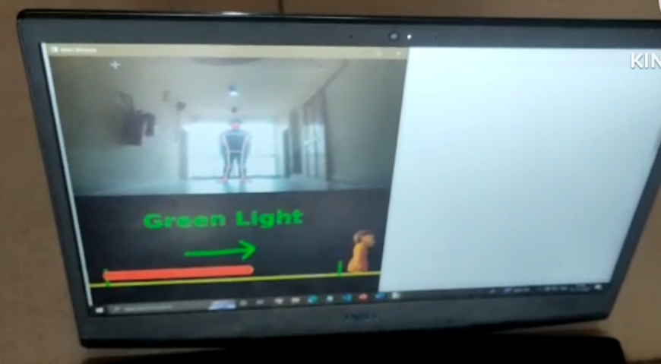
Result
If the whole body of the person is not visible then we get that
whole body should visible.
And when the whole body is visible then game will start
and from that when green light is shown we can move
or stay in the same position.

Slide 11
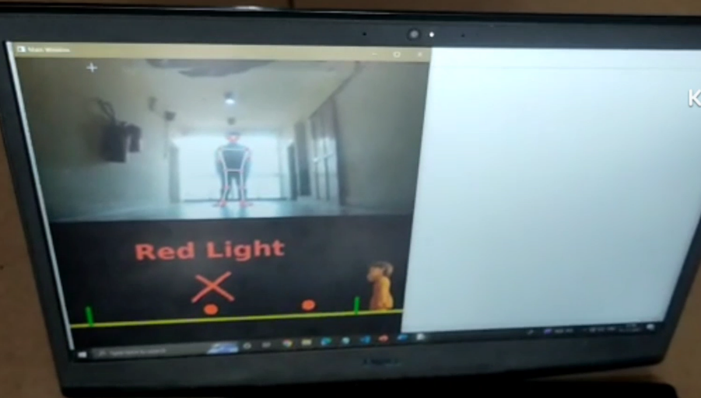
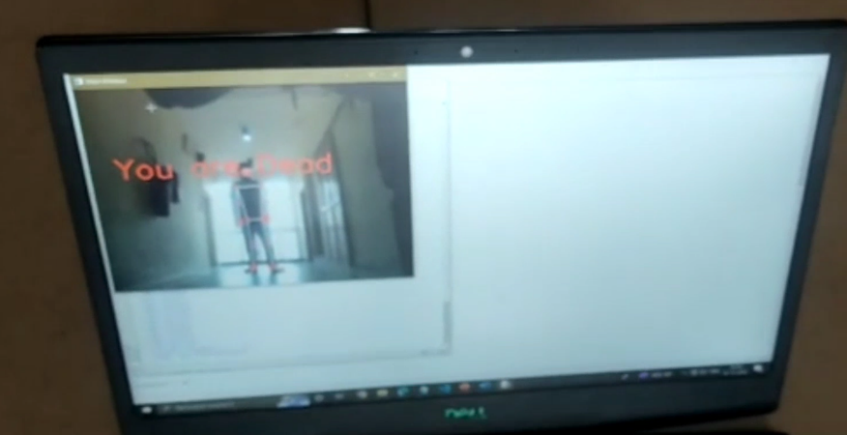
When the red light is shown we should not move from the place.
When we move at the time of red light then we are out of the
game and it shows you are dead.

Slide 12
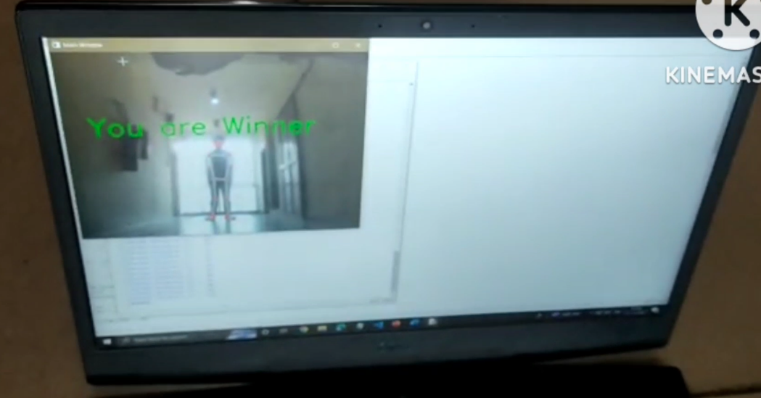
If we are alive for after 4 rounds then it will show you are winner

Slide 13
Team Members
1. B Gnaneshwar 2001CS15
2. C M DEVANAND 2001CS19
THANK YOU

